Slide 1
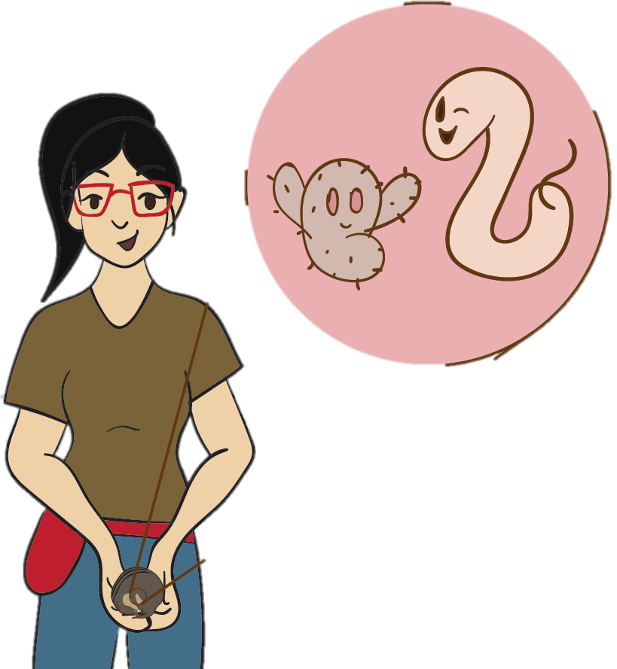
Prospectus Committee Meeting
Edna Chiang
3.14.2022

Slide 2
Outline
Timeline Overview
Aim 1 Summary – Completed
Aim 2 Summary – Completed
Aim 3 Update and Timeline
Notes:
- Start with quick overview of my timeline to give some context to everything
- Brief summary of Aims 1 & 2, which are completed
- Aim 3 is the last part that I’m trying to finish, so I’ll give an update on what I’ve accomplished and my plan for completing this aim by the time I graduate

Slide 3
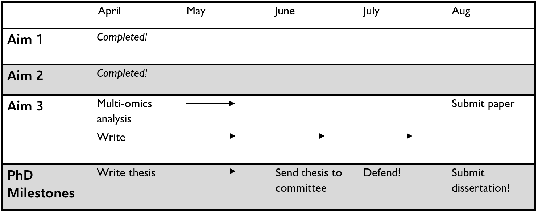
Timeline
Notes:
What I’ve built my timeline around is the fact that in Aug

Slide 4
Timeline
Move to Denver!
Notes:
I’ll be moving to Denver! Not for any particular reason except that my husband and I like the Denver-metro area. And it’s surprisingly a pretty good area to look for jobs in science communication and science policy, which are the fields that I’ll pursue after I graduate.
My lease in Madison ends Aug 14th, so I’ll be leaving sometime before then in the first half of Aug.
In order to make sure I defend before Aug…

Slide 5
Timeline
Move to Denver!
Notes:
- My plan is to defend in July, with the backup being June. My defense will either be virtual or hybrid, depending on how COVID-19 plays out. I’ll be presenting my defense over Zoom regardless, so there’s no need to be here in-person for that.
- Before my defense I will send you my thesis. And I have a question to you all– how far in advance would you like me to send you my thesis?

Slide 6
Gut microbiome response to nutritional changes in
a high fat diet mouse model and a ground squirrel hibernator

Slide 7
Gut microbiome response to nutritional changes in
a high fat diet mouse model and a ground squirrel hibernator

Slide 8
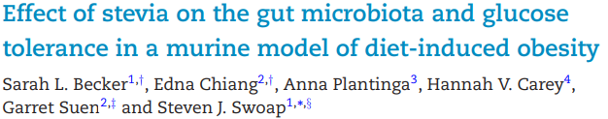
Aim 1
Notes:
Result of collab with Dr. Steve Swoap and his then-undergrad Sarah Becker at Williams College
- Published
- They approached Hannah, saying they had host side of the story, but needed helped with the microbe side, which is where I came in
- Since I was already studying the hibernation microbiome as a natural model of extreme nutritional changes, Hannah, Garret, and I decided that this project, which uses a mouse model common in microbiome studies, would be a nice complement to my work so that I gained experienced working with both a conventional mouse model, as well as the squirrel hibernation model, in the context of how nutritional changes affect the gut microbiome.

Slide 9
Aim 1
Goal: Determine if stevia alters gut microbiota and induces glucose intolerance

Slide 10
Aim 1
Goal: Determine if stevia alters gut microbiota and induces glucose intolerance
Results: In mice that are fed a high-fat diet, stevia supplementation induces similar microbiota changes as other artificial sweeteners and doesn’t impact glucose intolerance
Notes:
- Quick summary of Aim 1. Any questions/comments before I move on to Aim 2?

Slide 11
Gut microbiome response to nutritional changes in
a high fat diet mouse model and a ground squirrel hibernator

Slide 12
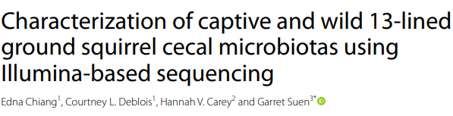
Aim 2
Animal Microbiome (2022)
Notes:
Published earlier this year

Slide 13
Aim 2
Animal Microbiome (2022)
Goals | Results
Compare captive and wild squirrel microbiotas

Slide 14
Aim 2
Animal Microbiome (2022)
Goals | Results
Compare captive and wild squirrel microbiotas | Compared to captive microbiota, wild microbiota has:

Slide 15
Aim 2
Animal Microbiome (2022)
Goals | Results
Compare captive and wild squirrel microbiotas | Compared to captive microbiota, wild microbiota has: - Greater richness and phylogenetic diversity

Slide 16
Aim 2
Animal Microbiome (2022)
Goals | Results
Compare captive and wild squirrel microbiotas | Compared to captive microbiota, wild microbiota has: - Greater richness and phylogenetic diversity - Less variation in beta diversity

Slide 17
Aim 2
Animal Microbiome (2022)
Goals | Results
Compare captive and wild squirrel microbiotas | Compared to captive microbiota, wild microbiota has: - Greater richness and phylogenetic diversity - Less variation in beta diversity - OTUs contributing to beta diversity in families Lachnospiraceae and Ruminococcaceae

Slide 18
Aim 2
Animal Microbiome (2022)
Goals | Results
Compare captive and wild squirrel microbiotas | Compared to captive microbiota, wild microbiota has: - Greater richness and phylogenetic diversity - Less variation in beta diversity - OTUs contributing to beta diversity in families Lachnospiraceae and Ruminococcaceae
Report changes in captive squirrel microbiotas across year
Notes:
Secondary goal

Slide 19
Aim 2
Animal Microbiome (2022)
Goals | Results
Compare captive and wild squirrel microbiotas | Compared to captive microbiota, wild microbiota has: - Greater richness and phylogenetic diversity - Less variation in beta diversity - OTUs contributing to beta diversity in families Lachnospiraceae and Ruminococcaceae
Report changes in captive squirrel microbiotas across year | Results consistent with previous work, except:

Slide 20
Aim 2
Animal Microbiome (2022)
Goals | Results
Compare captive and wild squirrel microbiotas | Compared to captive microbiota, wild microbiota has: - Greater richness and phylogenetic diversity - Less variation in beta diversity - OTUs contributing to beta diversity in families Lachnospiraceae and Ruminococcaceae
Report changes in captive squirrel microbiotas across year | Results consistent with previous work, except: - Summer vs. Spring - Low abundance taxa
Notes:
- Provides foundational info for improving reproducibility and experimental design of future hibernation microbiota studies
- Quick summary of Aim 2; any questions or comments before I move on to Aim 3?
- Quick refresher on the hibernation microbiome

Slide 21

Hibernation Microbiome Significance
Microbe-host symbioses:
fluctuating energy and nutrient availability
extreme changes in diet & physiology
Photo credit: www.naturalsara.files.wordpress.com/2014/04/summer-and-winter.jpg; www.freepik.com/free-photo/sandwich_1154059.html; www.gograph.com/stock-illustration/imedicine-packagedmedicine-single-icon-in-cartoon-gg96152510.html
Notes:
- Environments w/ fluctuating NRG…
- Hosts w/ extreme changes…
- What this microbe-host symbiosis looks like in the 13-lined ground squirrel is….

Slide 22
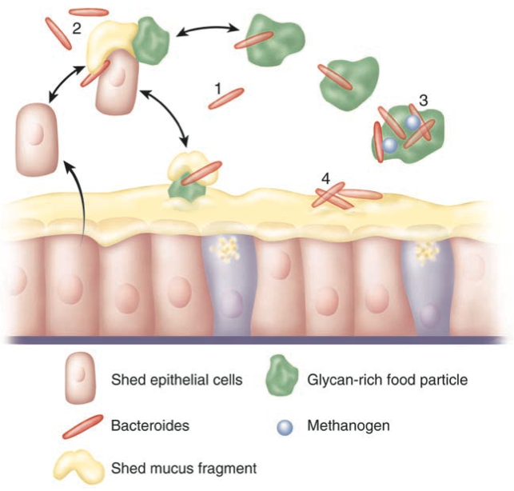
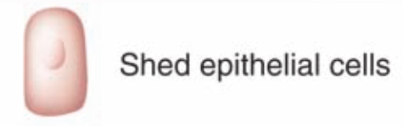
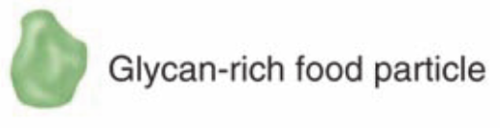
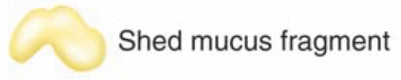
Microbe-Host Interactions
Summer
Spring
Host-derived Substrate
Dietary Substrate
Figure modified from Bäckhed, F., et.al. (2005) Science 307(5717):1915 – 1920

Slide 23
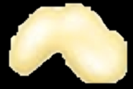
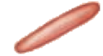


Microbe-Host Interactions
Winter
Host-derived Substrate
Dietary Substrate
Figure modified from Bäckhed, F., et.al. (2005) Science 307(5717):1915 – 1920
Notes:
- These seasonal changes in substrate availability are known to impact the microbiome

Slide 24
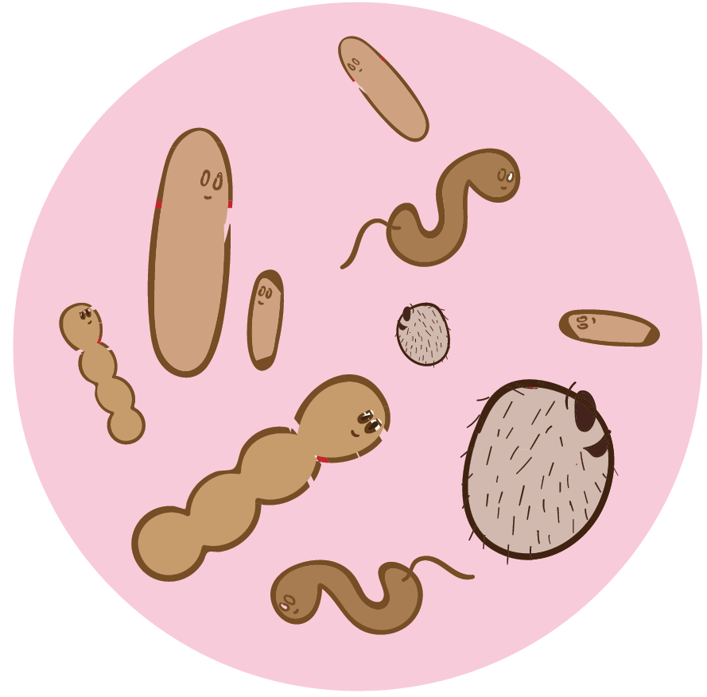

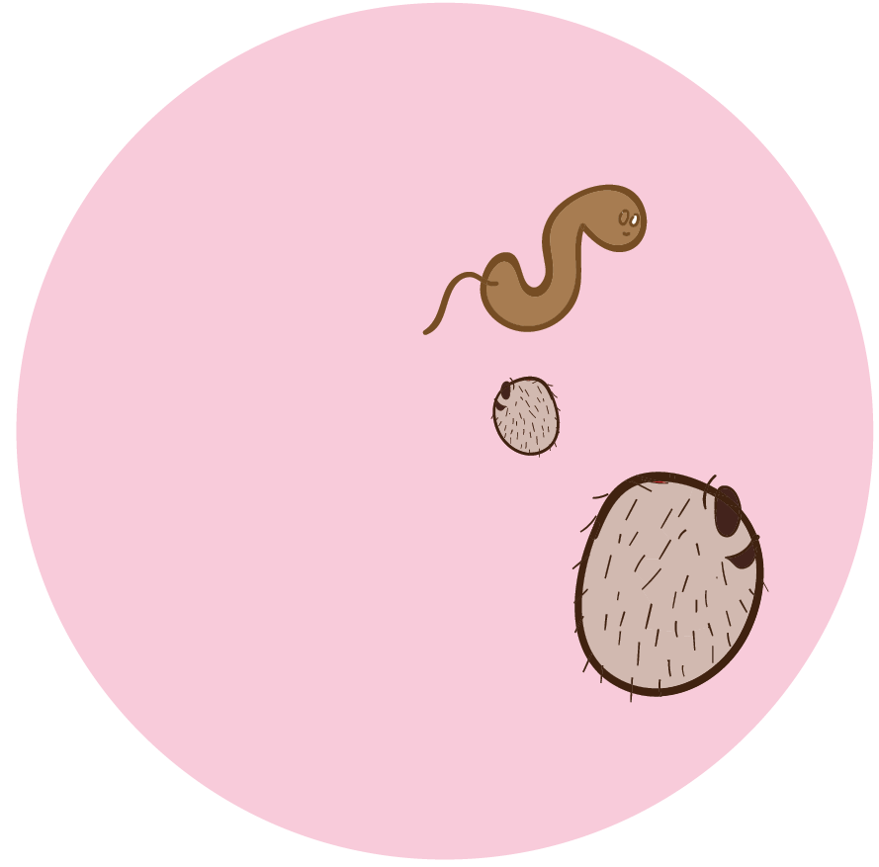
Changes in substrate availability impact microbial taxonomic composition
Spring
Winter
Summer
Illustration: Dr. Jaye Gardiner
Notes:
- But taxonomic info alone this doesn’t provide info on the genomic composition or functional potential of the microbiome
- This is the knowledge gap I’m addressing

Slide 25
Genomic Composition
Capacity for Dietary Carbohydrate Metabolism
Taxonomic Composition
Aim 3

Slide 26
Genomic Composition
Capacity for Dietary Carbohydrate Metabolism
Taxonomic Composition
Aim 3

Slide 27
Genomic Composition
Capacity for Dietary Inulin Metabolism
Taxonomic Composition
Aim 3

Slide 28
Aim 3
Goal: Link microbiome taxonomic and genomic composition to observed dietary inulin metabolism

Slide 29
Aim 3
Goal: Link microbiome taxonomic and genomic composition to observed dietary inulin metabolism
Hypotheses:
1) Winter has decreased capacity to metabolize dietary inulin compared to summer & spring

Slide 30
Aim 3
Goal: Link microbiome taxonomic and genomic composition to observed dietary inulin metabolism
Hypotheses:
1) Winter has decreased capacity to metabolize dietary inulin compared to summer & spring
2) Changes in dietary inulin metabolism are correlated with distinct genes and taxa

Slide 31
Aim 3
Goal: Link microbiome taxonomic and genomic composition to observed dietary inulin metabolism
Hypotheses:
1) Winter has decreased capacity to metabolize dietary inulin compared to summer & spring
2) Changes in dietary inulin metabolism are correlated with distinct genes and taxa
3) Taxa contribute significant metabolites to the host’s metabolic profile

Slide 32
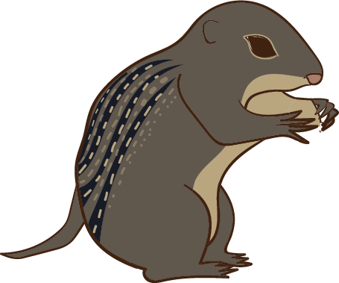
Aim 3 Methods
Antibiotic cocktail
Ampicillin (1.0 g/L)
Metronidazole (1.0 g/L)
Neomycin (1.0 g/L)
Vancomycin (0.5 g/L)
No Antibiotics
N = 42
N = 42
Antibiotic-treated
Illustration: Dr. Jaye Gardiner
Notes:
- In order to answer hypotheses, worked w/ Carey and Assadi-Porter Labs
- ABX vs. no ABX - ABX purpose = deplete gut microbiome
- ABX → via water bottle ad libitum

Slide 33
Aim 3 Methods
Summer (Jul - Sep)
Winter
(Jan - Mar)
Spring
(Mar - Apr)
Antibiotic cocktail
Ampicillin (1.0 g/L)
Metronidazole (1.0 g/L)
Neomycin (1.0 g/L)
Vancomycin (0.5 g/L)
No Antibiotics
N = 28
N = 28
N = 28
N = 42
N = 42
Antibiotic-treated
Illustration: Dr. Jaye Gardiner
Notes:
- summer & spring = 2 weeks of ABX water bottle before experiment
- winter = 2 weeks of water bottle before cold room entry, then 1 mL gavage booster every 4 weeks for a total of 3 boosters

Slide 34
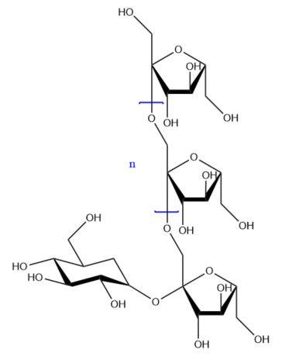
Aim 3 Methods
Summer (Jul - Sep)
Winter
(Jan - Mar)
Spring
(Mar - Apr)
Gavaged Substrates
¹³C-Inulin (500 mg/kg)
Only degradable by microbes
Saline
Negative control
No Antibiotics
N = 28
N = 28
N = 28
¹³C-Inulin
Saline
N = 42
N = 42
N = 42
N = 42
Antibiotic-treated
Inulin
Illustration: Dr. Jaye Gardiner
Notes:
- Receive 1 of 2 substrates
- Chose inulin bcuz (1) degradable by microbial enzymes but NOT host enzymes, and (2) they were available 13C-labeled

Slide 35
Aim 3 Methods
Summer (Jul - Sep)
Winter
(Jan - Mar)
Spring
(Mar - Apr)
Measure baseline exhaled δ¹³C
Measure exhaled δ¹³C
No Antibiotics
N = 28
N = 28
N = 28
¹³C-Inulin
Saline
N = 42
N = 42
N = 42
N = 42
Antibiotic-treated
Breath Experiment
Cavity-ring down spectroscopy (CRDS)
Picarro CRDS Machine
Illustration: Dr. Jaye Gardiner
Notes:
- Before & after substrate gavage, Placed in chamber connected to CRDS

Slide 36
Aim 3 Methods
Summer (Jul - Sep)
Winter
(Jan - Mar)
Spring
(Mar - Apr)
Measure baseline exhaled δ¹³C
Measure exhaled δ¹³C
No Antibiotics
N = 28
N = 28
N = 28
¹³C-Inulin
Saline
N = 42
N = 42
N = 42
N = 42
Antibiotic-treated
Breath Experiment
Cavity-ring down spectroscopy (CRDS)
Picarro CRDS Machine
Illustration: Dr. Jaye Gardiner
Notes:
- Chamber is open on one side to let fresh air in

Slide 37
Aim 3 Methods
Summer (Jul - Sep)
Winter
(Jan - Mar)
Spring
(Mar - Apr)
Measure baseline exhaled δ¹³C
Measure exhaled δ¹³C
No Antibiotics
N = 28
N = 28
N = 28
¹³C-Inulin
Saline
N = 42
N = 42
N = 42
N = 42
Antibiotic-treated
Breath Experiment
Cavity-ring down spectroscopy (CRDS)
Picarro CRDS Machine
Illustration: Dr. Jaye Gardiner
Notes:
on the other side it’s connected to a CRDS machine

Slide 38
Aim 3 Methods
Summer (Jul - Sep)
Winter
(Jan - Mar)
Spring
(Mar - Apr)
Measure baseline exhaled δ¹³C
Measure exhaled δ¹³C
No Antibiotics
N = 28
N = 28
N = 28
¹³C-Inulin
Saline
N = 42
N = 42
N = 42
N = 42
Antibiotic-treated
Breath Experiment
Cavity-ring down spectroscopy (CRDS)
Picarro CRDS Machine
Illustration: Dr. Jaye Gardiner
Notes:
- The air inside chamber becomes enriched in exhaled CO2 by the squirrel
- CRDS takes a sample of the air to…

Slide 39
Aim 3 Methods
Summer (Jul - Sep)
Winter
(Jan - Mar)
Spring
(Mar - Apr)
Measure baseline exhaled δ¹³C
Measure exhaled δ¹³C
No Antibiotics
N = 28
N = 28
N = 28
¹³C-Inulin
Saline
N = 42
N = 42
N = 42
N = 42
Antibiotic-treated
Breath Experiment
Cavity-ring down spectroscopy (CRDS)
δ¹³C
¹³CO₂ /¹²CO₂ ratio
Picarro CRDS Machine
Illustration: Dr. Jaye Gardiner
Notes:
- Calculate ratio of 13CO2 – 12CO2, called delta…verbally = delta value

Slide 40
Aim 3 Methods
Summer (Jul - Sep)
Winter
(Jan - Mar)
Spring
(Mar - Apr)
Measure baseline exhaled δ¹³C
Measure exhaled δ¹³C
No Antibiotics
N = 28
N = 28
N = 28
¹³C-Inulin
Saline
N = 42
N = 42
N = 42
N = 42
Antibiotic-treated
Breath Experiment
Cavity-ring down spectroscopy (CRDS)
δ¹³C
¹³CO₂ /¹²CO₂ ratio
Functional evidence of microbial/host metabolism
Picarro CRDS Machine
Illustration: Dr. Jaye Gardiner
Notes:
- 13C incorporation into exhaled CO2 is functional evidence of microbial/host metabolism
- delta13C = measures net function of all enzymatic pathways involved in substrate metabolism
- Breath samples taken every 15-20 min
- Duration of experiment was optimized for collecting metabolomics samples
- Inulin = 4.5 hrs
- Saline = 3 hrs

Slide 41
Aim 3 Methods
Summer (Jul - Sep)
Winter
(Jan - Mar)
Spring
(Mar - Apr)
Measure baseline exhaled δ¹³C
Measure exhaled δ¹³C
Cecum Content
Cecum Tissue (Mucosa)
Content DNA
Mucosa DNA
No Antibiotics
N = 28
N = 28
N = 28
¹³C-Inulin
Saline
N = 84
N = 84
N = 84
N = 84
N = 42
N = 42
N = 42
N = 42
Antibiotic-treated
Illustration: Dr. Jaye Gardiner
Notes:
- Tissue = proxy for mucosa

Slide 42
Aim 3 Methods
Summer (Jul - Sep)
Winter
(Jan - Mar)
Spring
(Mar - Apr)
Measure baseline exhaled δ¹³C
Measure exhaled δ¹³C
Cecum Content
Cecum Tissue (Mucosa)
Content DNA
Mucosa DNA
16S rRNA
Metagenomics
No Antibiotics
N = 28
N = 28
N = 28
¹³C-Inulin
Saline
N = 84
N = 84
N = 84
N = 84
N = 42
N = 42
N = 42
N = 42
Antibiotic-treated
Illustration: Dr. Jaye Gardiner

Slide 43
Aim 3 Methods
Summer (Jul - Sep)
Winter
(Jan - Mar)
Spring
(Mar - Apr)
Measure baseline exhaled δ¹³C
Measure exhaled δ¹³C
Cecum Content
Cecum Tissue (Mucosa)
Content DNA
Mucosa DNA
16S rRNA
Metagenomics
16S rRNA
No Antibiotics
N = 28
N = 28
N = 28
¹³C-Inulin
Saline
N = 84
N = 84
N = 84
N = 84
N = 42
N = 42
N = 42
N = 42
Antibiotic-treated
Illustration: Dr. Jaye Gardiner

Slide 44
Aim 3 Methods
Summer (Jul - Sep)
Winter
(Jan - Mar)
Spring
(Mar - Apr)
Measure baseline exhaled δ¹³C
Measure exhaled δ¹³C
Cecum Content
Cecum Tissue (Mucosa)
Content DNA
Mucosa DNA
16S rRNA
Metagenomics
16S rRNA
No Antibiotics
N = 28
N = 28
N = 28
¹³C-Inulin
Saline
N = 84
N = 84
N = 84
N = 84
N = 42
N = 42
N = 42
N = 42
Antibiotic-treated
Total 16S samples = 168
Illustration: Dr. Jaye Gardiner

Slide 45
Aim 3 Methods
Summer (Jul - Sep)
Winter
(Jan - Mar)
Spring
(Mar - Apr)
Measure baseline exhaled δ¹³C
Measure exhaled δ¹³C
Cecum Content
Cecum Tissue (Mucosa)
Content DNA
Mucosa DNA
16S rRNA
Metagenomics
16S rRNA
No Antibiotics
N = 28
N = 28
N = 28
¹³C-Inulin
Saline
N = 84
N = 84
N = 84
N = 84
N = 42
N = 42
N = 42
N = 42
Antibiotic-treated
Sequenced 16S samples = 120
Illustration: Dr. Jaye Gardiner
Notes:
- Samples that didn’t amplify were mostly from squirrels that received antibiotics, so not too surprising

Slide 46
Aim 3 Methods
Summer (Jul - Sep)
Winter
(Jan - Mar)
Spring
(Mar - Apr)
Measure baseline exhaled δ¹³C
Measure exhaled δ¹³C
Cecum Content
Cecum Tissue (Mucosa)
Content DNA
Mucosa DNA
16S rRNA
Metagenomics
16S rRNA
No Antibiotics
N = 28
N = 28
N = 28
¹³C-Inulin
Saline
N = 84
N = 84
N = 84
N = 84
N = 42
N = 42
N = 42
N = 42
Antibiotic-treated
Analyzed 16S samples = 44
Illustration: Dr. Jaye Gardiner
Notes:
- Samples that successfully survived quality control in mothur
- Most were from ABX squirrels or mucosal DNA, and there was many winter samples that had too few reads.

Slide 47
Aim 3 Methods
Summer (Jul - Sep)
Winter
(Jan - Mar)
Spring
(Mar - Apr)
Measure baseline exhaled δ¹³C
Measure exhaled δ¹³C
Cecum Content
Cecum Tissue (Mucosa)
Content DNA
Mucosa DNA
16S rRNA
Metagenomics
16S rRNA
No Antibiotics
N = 28
N = 28
N = 28
¹³C-Inulin
Saline
N = 84
N = 84
N = 84
N = 84
N = 42
N = 42
N = 42
N = 42
Antibiotic-treated
Analyzed 16S samples = 44
Total metagenomic samples = 18
9 inulin
9 saline
Illustration: Dr. Jaye Gardiner
Notes:
- No ABX, 3 from each season

Slide 48
Aim 3 Methods
Summer (Jul - Sep)
Winter
(Jan - Mar)
Spring
(Mar - Apr)
Measure baseline exhaled δ¹³C
Measure exhaled δ¹³C
Cecum Content
Cecum Tissue (Mucosa)
Content DNA
Mucosa DNA
16S rRNA
Metagenomics
16S rRNA
No Antibiotics
N = 28
N = 28
N = 28
¹³C-Inulin
Saline
N = 84
N = 84
N = 84
N = 84
N = 42
N = 42
N = 42
N = 42
Antibiotic-treated
Metabolomic samples:
Cecal content
Liver
Analyzed 16S samples = 44
Total metagenomic samples = 18
9 inulin
9 saline
Illustration: Dr. Jaye Gardiner

Slide 49
Aim 3 Methods
Summer (Jul - Sep)
Winter
(Jan - Mar)
Spring
(Mar - Apr)
Measure baseline exhaled δ¹³C
Measure exhaled δ¹³C
Cecum Content
Cecum Tissue (Mucosa)
Content DNA
Mucosa DNA
16S rRNA
Metagenomics
16S rRNA
No Antibiotics
N = 28
N = 28
N = 28
¹³C-Inulin
Saline
N = 84
N = 84
N = 84
N = 84
N = 42
N = 42
N = 42
N = 42
Antibiotic-treated
Completed
δ¹³C analysis
Metagenomic analysis
16S sequencing and analysis
Metabolomic cecal content analysis (by collaborators)
Illustration: Dr. Jaye Gardiner
Notes:
Cecal content = Summer and Winter

Slide 50
Aim 3 Methods
Summer (Jul - Sep)
Winter
(Jan - Mar)
Spring
(Mar - Apr)
Measure baseline exhaled δ¹³C
Measure exhaled δ¹³C
Cecum Content
Cecum Tissue (Mucosa)
Content DNA
Mucosa DNA
16S rRNA
Metagenomics
16S rRNA
No Antibiotics
N = 28
N = 28
N = 28
¹³C-Inulin
Saline
N = 84
N = 84
N = 84
N = 84
N = 42
N = 42
N = 42
N = 42
Antibiotic-treated
Completed
δ¹³C analysis
Metagenomic analysis
16S sequencing and analysis
Metabolomic cecal content analysis (by collaborators)
Uncompleted Multi-omic analyses:
Illustration: Dr. Jaye Gardiner

Slide 51
Aim 3 Methods
Summer (Jul - Sep)
Winter
(Jan - Mar)
Spring
(Mar - Apr)
Measure baseline exhaled δ¹³C
Measure exhaled δ¹³C
Cecum Content
Cecum Tissue (Mucosa)
Content DNA
Mucosa DNA
16S rRNA
Metagenomics
16S rRNA
No Antibiotics
N = 28
N = 28
N = 28
¹³C-Inulin
Saline
N = 84
N = 84
N = 84
N = 84
N = 42
N = 42
N = 42
N = 42
Antibiotic-treated
Completed
δ¹³C analysis
Metagenomic analysis
16S sequencing and analysis
Metabolomic cecal content analysis (by collaborators)
Uncompleted Multi-omic analyses:
Correlate microbial gene abundances with metabolites of interest
Predict and quantify microbial contributions to metabolite profile
Illustration: Dr. Jaye Gardiner
Notes:
- Mimosa2!

Slide 52
Aim 3 Methods
Summer (Jul - Sep)
Winter
(Jan - Mar)
Spring
(Mar - Apr)
Measure baseline exhaled δ¹³C
Measure exhaled δ¹³C
Cecum Content
Cecum Tissue (Mucosa)
Content DNA
Mucosa DNA
16S rRNA
Metagenomics
16S rRNA
No Antibiotics
N = 28
N = 28
N = 28
¹³C-Inulin
Saline
N = 84
N = 84
N = 84
N = 84
N = 42
N = 42
N = 42
N = 42
Antibiotic-treated
Completed
δ¹³C analysis
Metagenomic analysis
16S sequencing and analysis
Metabolomic cecal content analysis (by collaborators)
Uncompleted Multi-omic analyses:
Correlate microbial gene abundances with metabolites of interest
Predict and quantify microbial contributions to metabolite profile
Illustration: Dr. Jaye Gardiner

Slide 53
Aim 3 Methods
Summer (Jul - Sep)
Winter
(Jan - Mar)
Spring
(Mar - Apr)
Measure baseline exhaled δ¹³C
Measure exhaled δ¹³C
Cecum Content
Cecum Tissue (Mucosa)
Content DNA
Mucosa DNA
16S rRNA
Metagenomics
16S rRNA
No Antibiotics
N = 28
N = 28
N = 28
¹³C-Inulin
Saline
N = 84
N = 84
N = 84
N = 84
N = 42
N = 42
N = 42
N = 42
Antibiotic-treated
Completed
δ¹³C analysis
Metagenomic analysis
16S sequencing and analysis
Metabolomic cecal content analysis (by collaborators)
Uncompleted Multi-omic analyses:
Correlate microbial gene abundances with metabolites of interest
Predict and quantify microbial contributions to metabolite profile
Illustration: Dr. Jaye Gardiner
Notes:
- Show what I’ve accomplished this year

Slide 54
Breath curves

Slide 55
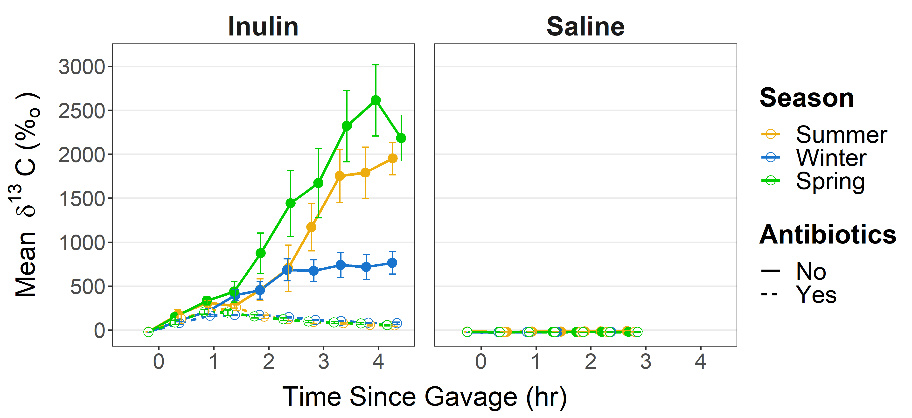
Breath curves

Slide 56
Breath curves

Slide 57
Breath curves

Slide 58
Breath curves
Notes:
- Bars = SD

Slide 59
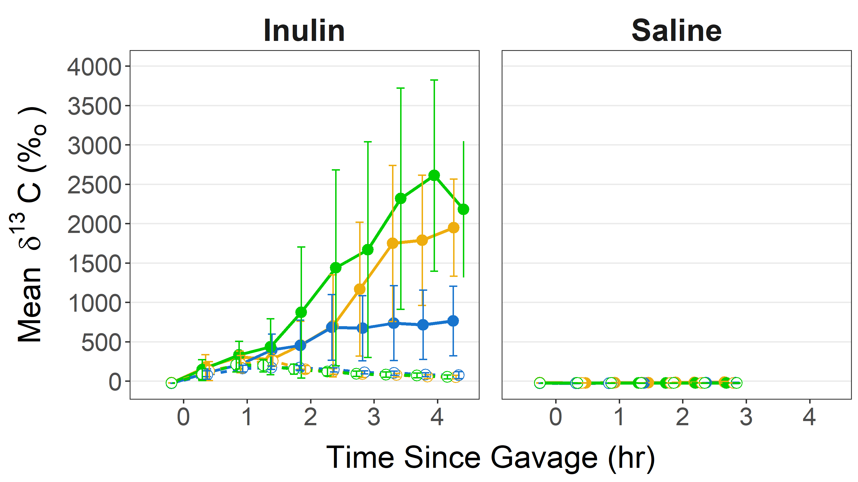
Breath curves
Notes:
Fariba & I decided to use 2 metrics to evaluate the breath curves.
The first is…

Slide 60
Total observed metabolism = area under curve
Notes:
A measure of total observed metabolism → AUC
Inulin metabolism includes both microbial & host metabolism

Slide 61
Total observed metabolism = area under curve
Notes:
A measure of total observed metabolism → AUC
Inulin metabolism includes both microbial & host metabolism

Slide 62
Total observed metabolism = area under curve
Notes:
A measure of total observed metabolism → AUC
Inulin metabolism includes both microbial & host metabolism

Slide 63
Does total observed metabolism differ by season?
Notes:
- More specifically, lower in Winter?

Slide 64
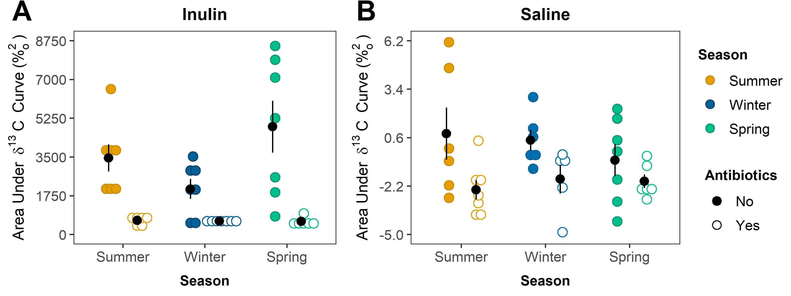
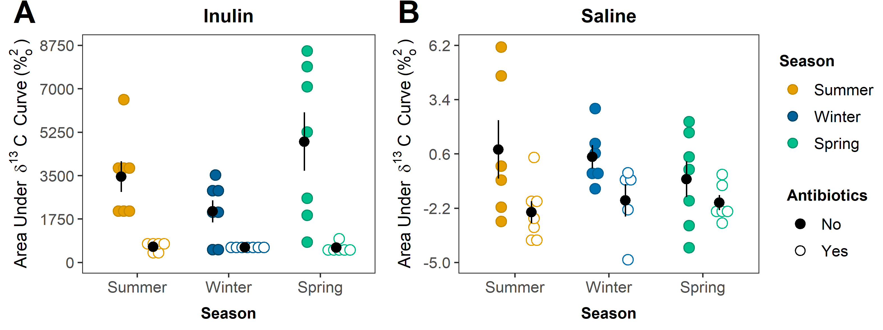
Does total observed metabolism differ by season?
Notes:
- Black dot = mean
- Bars = SE

Slide 65
Total observed metabolism does not differ by season
Kruskal-Wallis P = 0.16
Seasons do not differ

Slide 66
Total observed metabolism does not differ by season
Kruskal-Wallis P = 0.16
Fligner-Kileen adj P = 0.02
Seasons do not differ
Spring has highest variance

Slide 67
Total observed metabolism does not differ by season
Kruskal-Wallis P = 0.16
Fligner-Kileen adj P = 0.02
Seasons do not differ
Spring has highest variance
Antibiotics are effective
Notes:
- ABX Sig in Summer and Spring
- ABX not sig in Winter

Slide 68
Total observed metabolism does not differ by season
Kruskal-Wallis P = 0.16
Fligner-Kileen adj P = 0.02
Seasons do not differ
Spring has highest variance
Antibiotics are effective

Slide 69
Total observed metabolism does not differ by season
Kruskal-Wallis P = 0.16
Fligner-Kileen adj P = 0.02
ANOVA P = 0.41
Fligner-Kileen P = 0.83
Seasons do not differ
Spring has highest variance
Antibiotics are effective
Seasons do not differ

Slide 70
Total observed metabolism does not differ by season
Kruskal-Wallis P = 0.16
Fligner-Kileen adj P = 0.02
ANOVA P = 0.41
Fligner-Kileen P = 0.83
Seasons do not differ
Spring has highest variance
Antibiotics are effective
Seasons do not differ
Within season, no difference in antibiotic treatment

Slide 71
Breath curves
Notes:
The 2nd breath curve metric was…

Slide 72
Maximum metabolic rate = Highest Slope

Slide 73
Maximum metabolic rate = Highest Slope

Slide 74
Maximum metabolic rate = Highest Slope

Slide 75



Does maximum metabolic rate differ by season?
Summer
Winter
Spring
Notes:
- Lower in winter

Slide 76
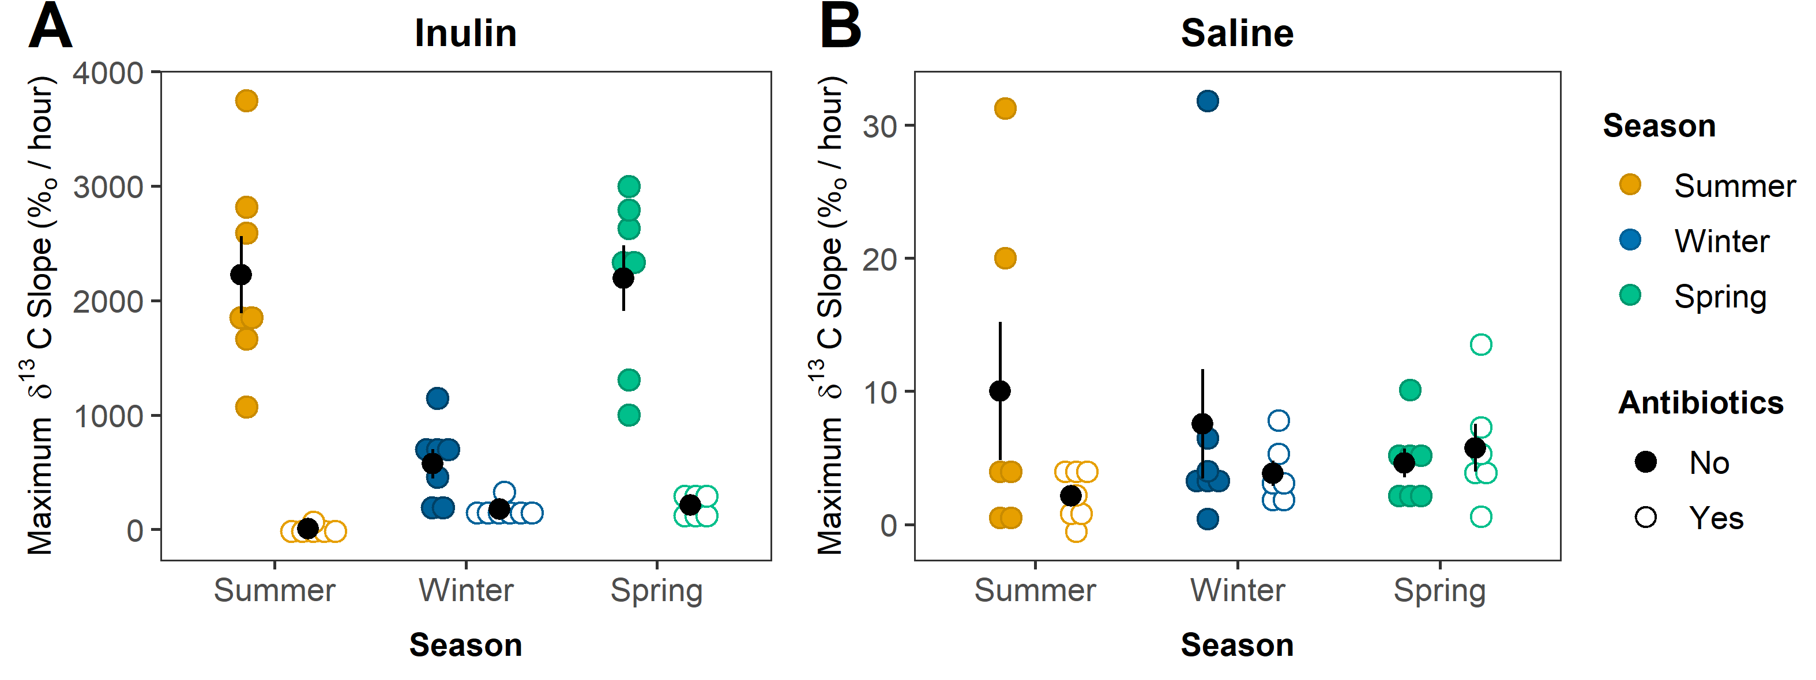
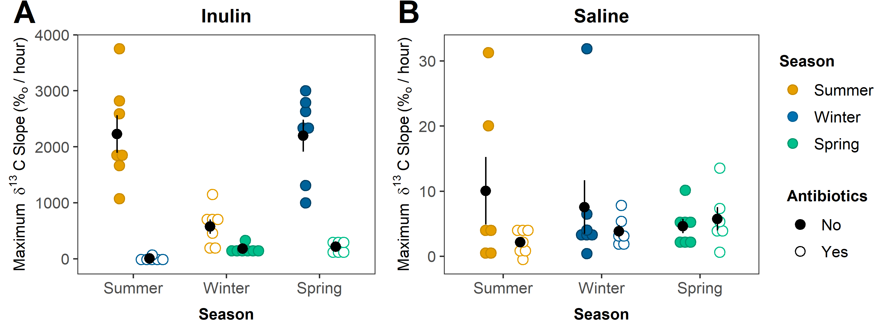
Does maximum metabolic rate differ by season?

Slide 77
Maximum metabolic rate has seasonal differences
Tukey HSD adj P’s ≤ 0.002
No antibiotics: Winter < Summer, Spring

Slide 78
Maximum metabolic rate has seasonal differences
All Tukey HSD adj P’s ≤ 0.002
No antibiotics: Winter < Summer, Spring
Antibiotic treated: Summer < Winter, Spring
Notes:
- Could be due to diff taxa in Summer surviving the ABX compared to Wi/Sp
- 16S in Summer & Winter content samples for ABX, they had very diff taxa that dominated the surviving microbiota. - Winter – half of microbiota was one OTU in the genus Morganella, members of which have previously been identified as ABX-resistant. - Summer – More balanced microbiota in terms of evenness. Top two OTUs were in genus Bacteroides and in order Clostridiales - Fewer taxa in Summer that can degrade inulin compared to Winter and Spring?

Slide 79
Maximum metabolic rate has seasonal differences
All Tukey HSD adj P’s ≤ 0.002
Both Fligner-Killeen Ps > 0.15
No antibiotics: Winter < Summer, Spring
Antibiotic treated: Summer < Winter, Spring
Notes:
No diff in variance

Slide 80
Maximum metabolic rate has seasonal differences
All Tukey HSD adj P’s ≤ 0.002
Both Fligner-Killeen Ps > 0.15
No antibiotics: Winter < Summer, Spring
Antibiotic treated: Summer < Winter, Spring

Slide 81
Maximum metabolic rate has seasonal differences
All Tukey HSD adj P’s ≤ 0.002
Both Fligner-Killeen Ps > 0.15
Both Kruskal-Wallis P’s > 0.20
Both Fligner-Kileen P’s ≥ 0.50
No antibiotics: Winter < Summer, Spring
Antibiotic treated: Summer < Winter, Spring
Seasons do not differ
Notes:
Having identified some diff in delta values….
What taxa or genes in the microbiome are associated with these changes?
MetaG

Slide 82
Does exo-inulinase gene abundance decrease in Winter?
Summer
Winter
Spring
Notes:
reads per kilobase per genome equivalent (RKPG)
- Like normalized per microbial cell

Slide 83
Exo-inulinase gene abundance doesn’t change seasonally
Summer
Winter
Spring
Kruskal-Wallis P = 0.598
Fligner-Killeen P = 0.143

Slide 84
Exo-inulinase gene abundance doesn’t change seasonally
Suggests that observed changes in δ¹³C are due to gene expression rather than gene abundance
Summer
Winter
Spring
Kruskal-Wallis P = 0.598
Fligner-Killeen P = 0.143
Notes:
- Caveat = doesn’t account for changes in absolute abundance - Even if there’s no change in inulinase genes per cell, if Winter has fewer microbial cells than Summer and Spring, one could extrapolate that Winter has a decreased capacity for inulin degradation. - No absolute abundance data, but we have DNA yield from sample extractions as proxy for microbial abundance
- Active = 7e+11 cells - Late hib = 3e+11 cells
Even though gene abundance doesn’t change, what about taxa that encode the gene?

Slide 85
Spring has higher DNA yield than Summer
a ab b
ANOVA P = 0.047
Tukey HSD adj P for Summer vs. Spring = 0.0499
Notes:
Spring has higher DNA yield than Summer
Reiterate that DNA yield is just a proxy for microbial abundance since the DNA also contains host DNA & DNA from food being digested, and I’m not sure if we would expect that DNA to increase in Spring compared to Summer.
- Active = 7e+11 cells - Late hib = 3e+11 cells
Even though gene abundance doesn’t change, what about taxa that encode the gene?

Slide 86
Spring has higher DNA yield than Summer
Spring may have higher microbial abundance than Summer
a ab b
ANOVA P = 0.047
Tukey HSD adj P for Summer vs. Spring = 0.0499
Notes:
- Active = 7e+11 cells - Late hib = 3e+11 cells
Even though gene abundance doesn’t change, what about taxa that encode the gene?

Slide 87
Spring has higher DNA yield than Summer
Spring may have higher microbial abundance than Summer
Spring may have larger capacity for inulin metabolism than Summer
a ab b
ANOVA P = 0.047
Tukey HSD adj P for Summer vs. Spring = 0.0499
Notes:
- Reiterate that DNA yield is just a proxy for microbial abundance since the DNA also contains host DNA & DNA from food being digested
- It would be interesting for future studies to incorporate absolute abundance into their analysis to see if this estimate is correct
- Active = 7e+11 cells - Late hib = 3e+11 cells
Having explored exo-inulinase gene abundance, next wanted to do whether taxa encoding these genes were similar across seasons

Slide 88
Exo-inulinase genes are not encoded by similar taxa across seasons
More genes during hibernation are encoded by Bacteroidetes
Summer
Winter
Spring
Wilcoxon Adj P < 0.001

Slide 89
Exo-inulinase genes are not encoded by similar taxa across seasons
More genes during hibernation are encoded by Bacteroidetes
Active season genes classified to higher % of all other bacterial & fungal phyla
Summer
Winter
Spring
All Wilcoxon Adj P < 0.001
Notes:
- Ascomycota, a fungal phylum, was absent in hibernating squirrels
- Overall, fewer taxa observed in hibernating squirrels than in active squirrels

Slide 90
Exo-inulinase gene species-level classification
Summer
Winter
Spring
Wilcoxon adj P = 0.05 Wilcoxon adj P = 0.05
Power = 0.92 Power = 0.82
Notes:
- At the species-level, only had sufficient power to identify trends in Bacteroides heparinolyticus and a Prevotella sp.
- Still need to do reading on these, but I’m showing them as examples of species that I’ll focus on

Slide 91
Exo-inulinase gene bacterial species-level classification
Summer
Winter
Spring
Notes:
- I’ll also be looking into species that had high relative abundances across almost all samples

Slide 92
Exo-inulinase gene fungal species-level classification
Summer
Winter
Spring
Notes:
- Fungal species because most inulinase research has been done in fungi for use in industry
- Fungi are only in some active squirrels and not in hib squirrels
- Now that I’ve focused specifically on taxa that encode the exo-inulinase genes, I wanted to take a step back and broadly examine all taxa in microbiota, not just those than encoded inulinase genes.

Slide 93
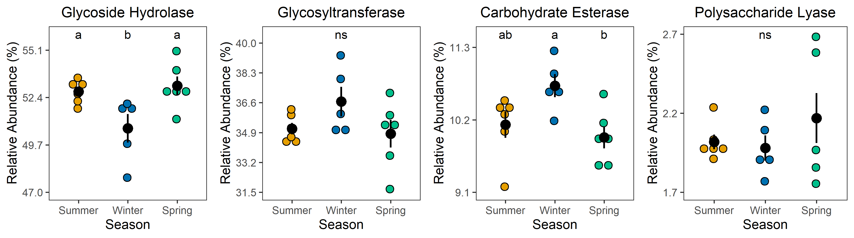
A B C D
Notes:
Class → family
GH = break glycosidic bonds via hydrolysis
GT = form glycosidic bonds
CE = break carb esters via hydrolysis (catalyze the de-O or de-N-acylation of substituted saccharides)
PL = break glycosidic bonds (non-hydrolytic mechanism)

